Slide 1
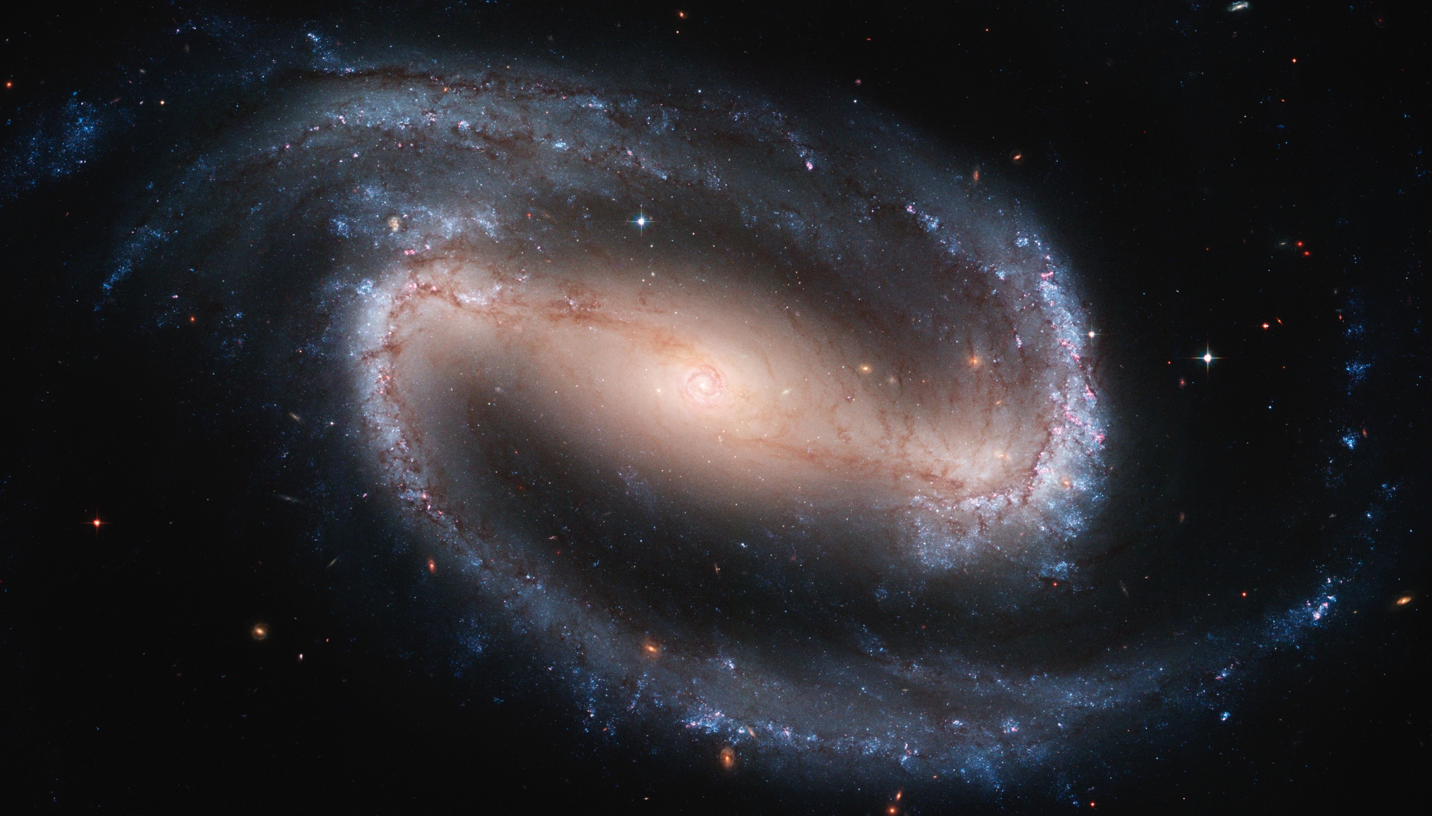
NServiceBus introduction
Boris Tveritnev
27/08/2015
http://apod.nasa.gov/apod/image/1203/ngc1300_hst_6637.jpg

Slide 2





Particular software
NServiceBus
Messaging and Workflow
ServicePulse
Production Monitoring
ServiceMatrix
Modelling & Design
ServiceInsight
Advanced Debugging

Slide 3
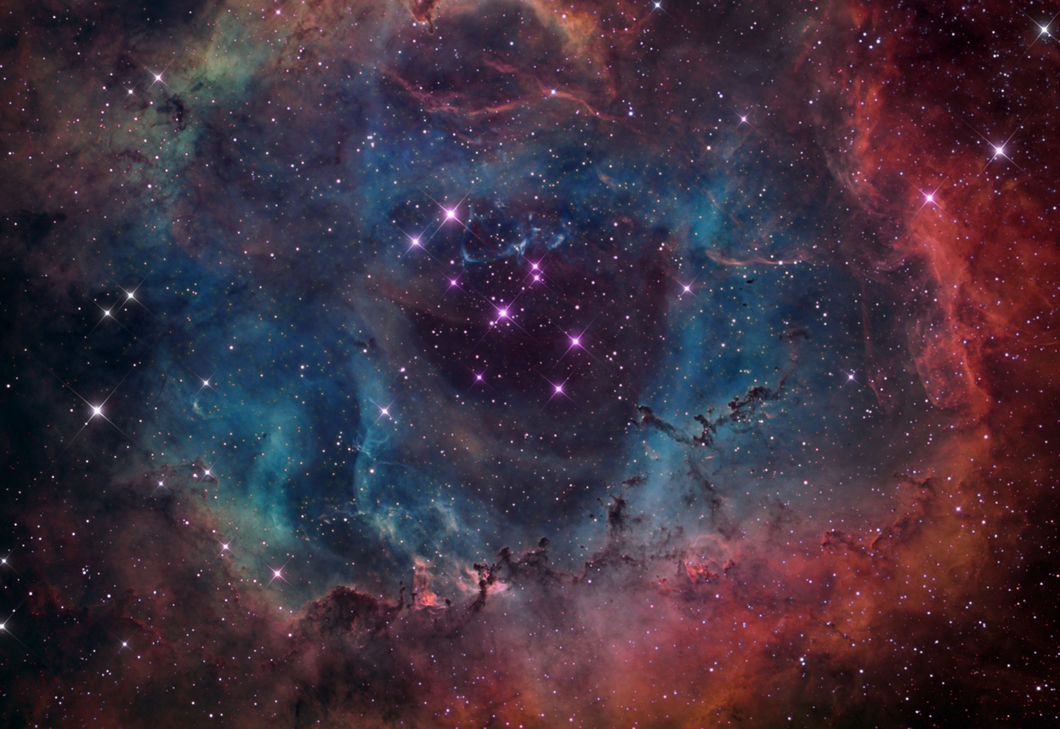
What service bus is?
It’s all in the message - The trick is to think of your system as passing messages at the application level as well.
Once you’ve packaged everything into the message, that message can be dynamically routed anywhere, and so can its responses. The application doesn’t need to bind against any specific endpoint—it just drops a message addressed to some logical location. Infrastructure can make sure that messages get to the logical recipient, even if they change physical locations.
That infrastructure is what brings about the “Bus” architectural style between your distributed components.
http://www.heavensgloryobservatory.com/Color_Jpegs/ngc2244NB03.jpg

Slide 4
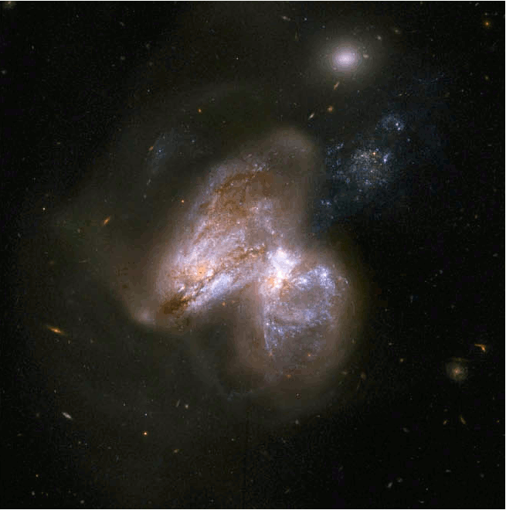
Why bother?
Deadlocks under load
Order processing failures - we lose money.
Put yours
http://www.space.com/28254-monster-black-hole-nasa-nustar-image.html

Slide 5
Example 1
Reliable requests processing

Slide 6
What service bus is?
It’s all in the message - The trick is to think of your system as passing messages at the application level as well.
Once you’ve packaged everything into the message, that message can be dynamically routed anywhere, and so can its responses...
http://www.heavensgloryobservatory.com/Color_Jpegs/ngc2244NB03.jpg

Slide 7
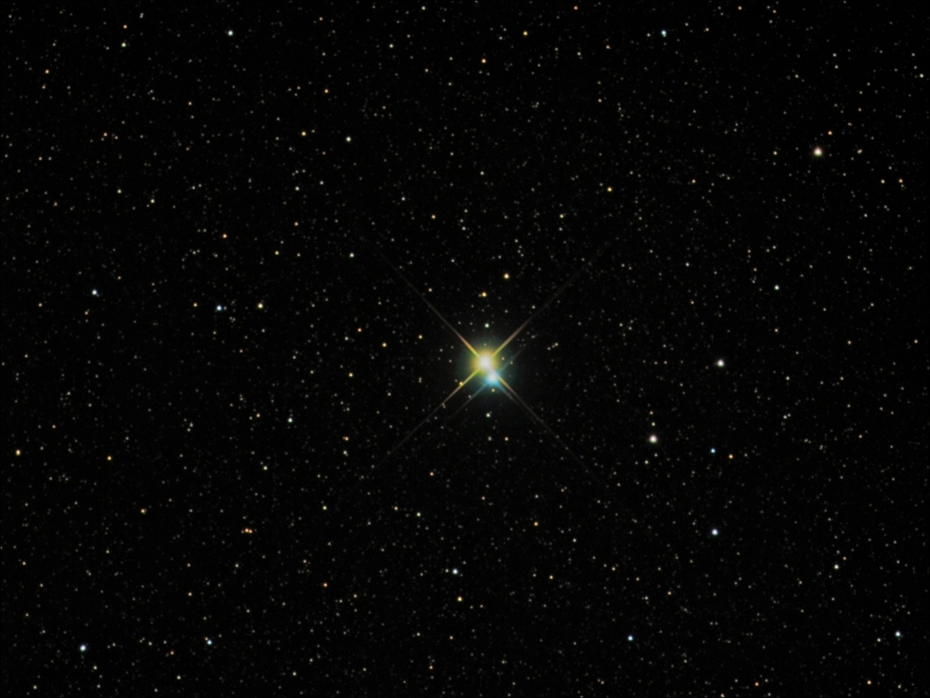
Asynchronous messaging
Command messages (Request-Response)
Event messages (Publish-Subscribe)
http://apod.nasa.gov/apod/image/0508/albireo_yandrik_big.jpg

Slide 8
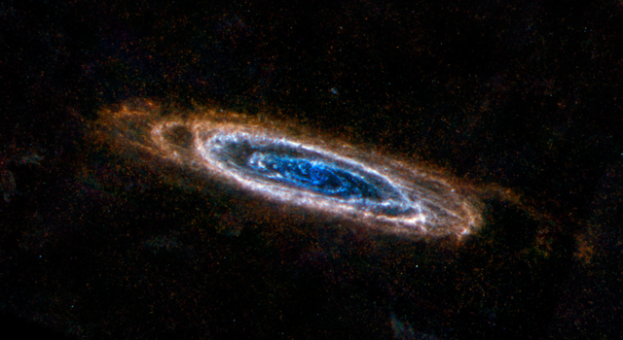
Request-Response, kinda
Many clients, one server
Server’s capabilities are known
Server’s location is known
Strong coupling
http://www.mdscc.nasa.gov/upload/201301/andromeda.jpg

Slide 9
Distributed systems fallacies
The network is reliable
Latency isn’t a problem
Bandwidth isn’t a problem
The network is secure
The topology won’t change
The administrator will know what to do
Transport cost isn’t a problem
The network is homogenous

Slide 10
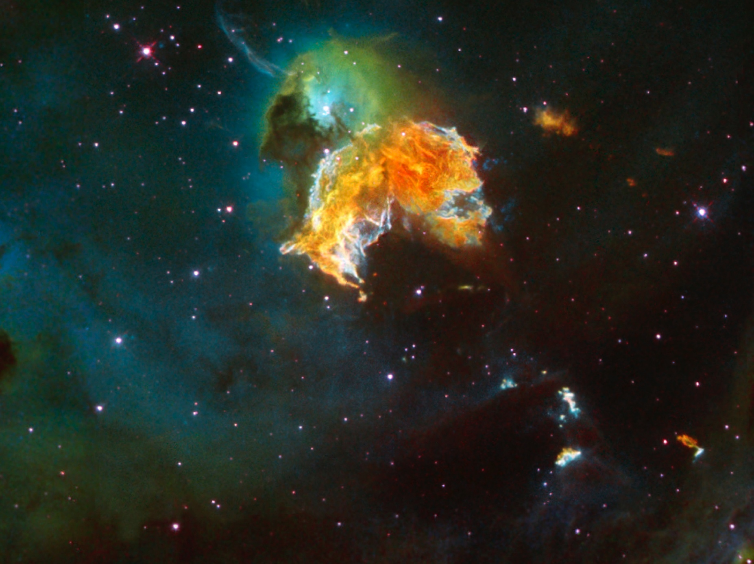
Eventual consistency
Consistency (for a short period)
Availability
Partition tolerance
http://www.nasa.gov/sites/default/files/images/117227main_image_feature_342_ys_full.jpg

Slide 11
Publish-subscribe
One (logical) publishing authority, many subscribers
Publisher doesn’t care about subscribers
Loose coupling
http://www.mdscc.nasa.gov/upload/201301/andromeda.jpg

Slide 12
Example 2
Loosely coupled services with Publish-Subscribe

Slide 13
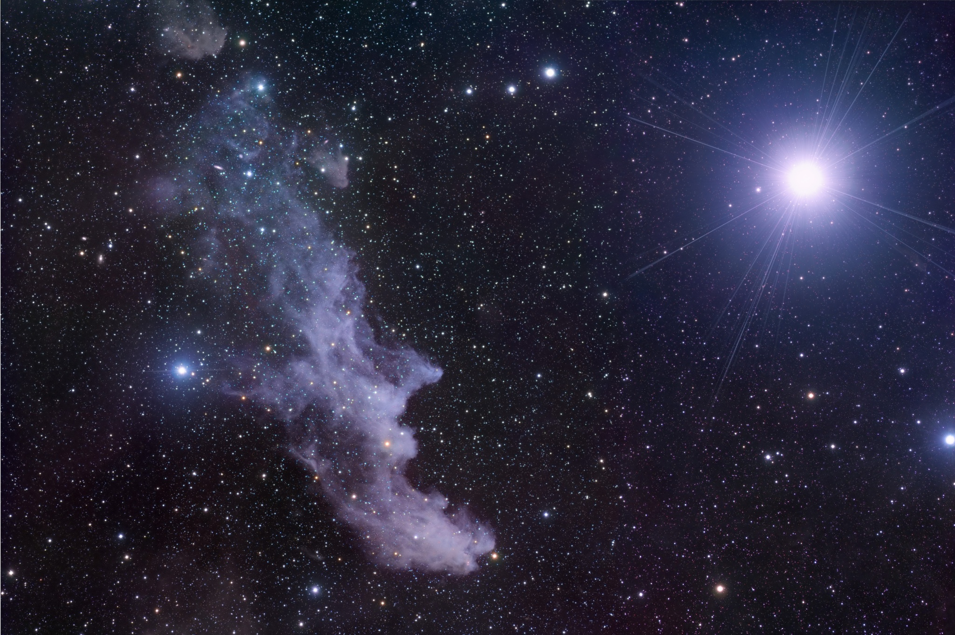
Messaging transports
SQL Server Service Broker
AMQP brokers (ActiveMQ, RabbitMQ)
Cloud queues (Azure Queue, Amazon SQS)
Many more
http://apod.nasa.gov/apod/image/0810/ic2118_ssro.jpg

Slide 14
What service bus is?
…The application doesn’t need to bind against any specific endpoint—it just drops a message addressed to some logical location. Infrastructure can make sure that messages get to the logical recipient, even if they change physical locations.
That infrastructure is what brings about the “Bus” architectural style between your distributed components.
http://www.heavensgloryobservatory.com/Color_Jpegs/ngc2244NB03.jpg

Slide 15
Long-running processes
A retailer can't ship a product until after the CC has been charged
Spending a certain amount of money can a customer attain a preferred status
Premium membership is in effect as long as all invoices were paid in time
http://www.nasa.gov/sites/default/files/images/117227main_image_feature_342_ys_full.jpg

Slide 16

Saga patterns
Controller that actively manages a business process activities
Observer, passively listening to external events, coordinating some activity
Mixed
http://i.stack.imgur.com/lFnDf.jpg

Slide 17
Example 3
Long running process

Slide 18
More info
http://particular.net/HandsOnLabs
http://particular.net/Videos-and-Presentations
http://www.udidahan.com/?blog=true
Examples and slides
https://www.spacetelescope.org/images/potw1530a/

Slide 19
References
D. Boike, Learning NServiceBus, Packt Publishing 2013, ISBN-13: 978-1782166344
http://www.cs.cornell.edu/andru/cs711/2002fa/reading/sagas.pdf
https://lostechies.com/jimmybogard/2013/05/14/saga-patterns-wrap-up/
G. Hohpe, Enterprise Integration Patterns, Addison-Wesley Professional 2003, ISBN-13: 978-0321200686
https://www.spacetelescope.org/images/potw1530a/

Slide 20
Thank you
Boris Tveritnev, 2015

